Slide 1
TDD Kata
Writing tests first, to “drive” out the behaviour of the application.

Slide 2
TDD Steps
Write a single unit test describing a feature of the application.
Run the test, which should fail because the application lacks that feature.
Write “just enough” code, the simplest possible, to make the test pass.
Refactor the code until you are happy with the design.
Repeat, for the next feature.

Slide 3
Write a test
Make it Pass
Refactor your code

Slide 4
Red
Green
Refactor

Slide 5
Why I like TDD
You automatically end up with good unit test coverage – because everything you add is to make a test pass.
You immediately get feedback when you have regressed and broken a piece of functionality.
I feel that TDD helps to drive out “good” design in a system.
TDD is another tool or technique that you can choose to use when you think it would be helpful.
Works well when pairing: you write test , they make it pass, they write test, you make it pass, etc.

Slide 6
FizzBuzz Kata
Write a program that prints the numbers from 1 to 100. But for multiples of three print “Fizz” instead of the number and for the multiples of five print “Buzz”. For numbers which are multiples of both three and five print “FizzBuzz “.

Slide 7
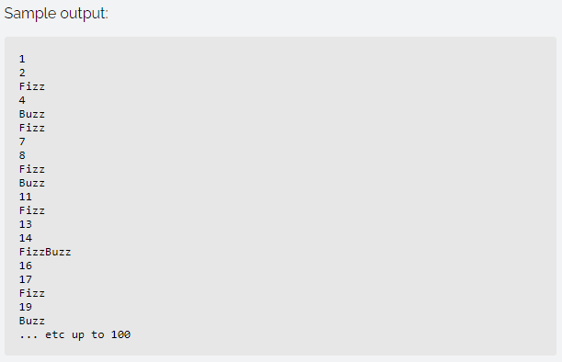

Slide 8
String Calculator
Step 1:
method can take 1 or 2 comma-separated numbers, and will return their sum.
method returns 0 when passed the empty string.
Step 2:
method can handle an unknown amount of numbers.

Slide 9
String Calculator Extended
Step 1
Add Logging Abilities to your new String Calculator (to an ILogger.Write()) interface.
Every time you call Add(), the sum result will be logged to the logger.
Step 2
When calling Add() and the logger throws an exception, the string calculator should notify an IWebservice of some kind that logging has failed with the message from the logger’s exception.
Step3
Add a timestamp with millisecond accuracy to the message when notifying the WebService

Slide 10
Roman Numerals
[InlineData("I", 1)]
[InlineData("II", 2)]
[InlineData("III", 3)]
[InlineData("IV", 4)]
[InlineData("V", 5)]
etc

